Slide 1
YWCC 307 Group Presentation:
Where Finance Meets Social - DivvyTrip
Amin Rhriyeb, Nahian Ahmed, Brennian Lush, Paul Yoo
Notes:
The intersection of social and finance—as well as shifting attitudes around what we share about money online—have given way to an ambitious new wave of financial products. Your team is preparing an analysis for a client about a potential new product in social finance area. Research the current state of art products on the market and make a case for a new app (product) for an under-served market. Your analysis should include strategy, innovation as well as disruption in the target market.

Slide 2

Introduction
Often times when organizing group trips the topic of budgeting arises.
Rather than having to calculate your trip expenses and figure out who owes what we have the solution.
New and upcoming in the social finance area we present DivvyTrip; the app to help you calculate group expenses and distribute them to display who owes what.
Notes:
Intro: Amin
Mission: Nahian
Competitors:Brennian
How we help you:
subtopics: prod. features & innovation Paul
Conclusion: Amin
Split bills evenly for trips
Unique feature: collect the splitted money altogether and pay towards the trip

Slide 3

Our Mission
Making group events fair and equal for all
Helping with consistent contribution of all members
Eliminating the pain of an equal dues sharing concept for trips
Saving friendships and relationships
Allowing trips and outing events to be more convenient

Slide 4


Slide 5

A scenario supporting our mission
Without Divvy Trip
Setting the scene: Your friends and you are trying to book a cabin using Airbnb. Based on the booking rate, one of your friends does calculations on top of his head and asks everyone in your group to pay a certain amount to him using Cashapp. He then gathers all the money into his account to pay for the rental of the cabin and figures out that he is still a few hundred dollars short for booking the cabin
Outcome: Someone else books the cabin before your group and now you and your friends have to figure out the shortcomings and make undesirable changes to your trip.
With Divvy Trip:
Setting the scene: You put the booking rate on our application and the number of people in your group. The application calculates how much money everyone has to chip in. All your friends pays the calculated amount on the application and your group is now all set to pay for the cabin rentals.
Outcome: No undesirable or last minute changes has to be made. Your plan is all set to become a reality.

Slide 6
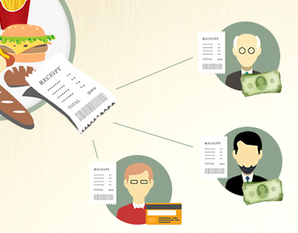




Competitors
Some of the competitors in social finance include Splitwise, Tab, Settle Up, and Splid. Each of them offer similar services that provide easy ways to split up bills and pay debts within groups.
Among these apps there are those that are designed to be more specialized and those for general purpose
Splitwise is considered to be the best overall
Splid is more customized to be used for group trips

Slide 7
Splitwise
Splitwise provides a mobile application and web platform to organize expenses.
It keeps track of your expenditures and any IOU’s.
However, it doesn't have an in-app payment functionality so you’ll have to rely on third party applications for any transactions
This makes the user experience clunky as you have to move between Splitwise and your banking app
This will only work if all your friends actively check the app
The free version has a 2-3 transaction per day limit anyone that doesn't have Pro is barely able to use the application.

Slide 8
Splid
Splid is an expense splitting app. Users can create groups, add expenses, and add the names of people with whom the bill has to been shared.
Splid also shows you who owes how much to whom so there are no confusions when it comes to where the money should go.
Splid also handles and can convert between multiple currencies which is useful for trips to foreign countries

Slide 9
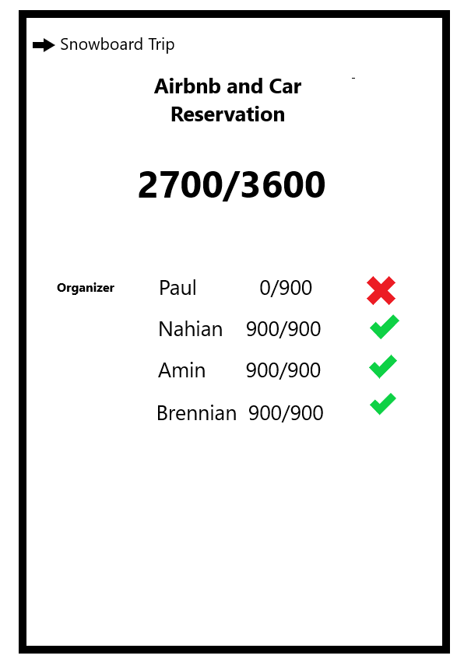
Innovation
DivvyTrip is a bill splitting app intended for people traveling as a group.
Our app will divide the expense equally among the group of users.
Our innovation is a money pooling feature for the organizer to use for booking reservations.
Organizer will be able to use the pooled money to pay for the reservations rather than pay out of their own pocket and have to worry about collecting money from each person.

Slide 10

Why is DivvyTrip useful?
Frees the organizer from straining relationships over collecting money.
Showing each person’s contribution publicly leaves the responsibility to each individual.
App will also contain peer-to-peer payments for small expenses.
Groups will be able to contain all expenses such as restaurant, entertainment, and transportation owed in one application.

Slide 11

Conclusion
In conclusion we have presented DivvyTrip as an easy to use application to make group trips easier with friends, family, etc.
By offering the convenience of our application many issues can be taken care of.
Additionally our application offers what our competitors cannot in assisting specifically with trip planning.

Slide 12
Works Cited
https://www.investopedia.com/articles/company-insights/090816/how-splitwise-works-and-makes-money.asp#toc-splitwises-industry
https://www.cbinsights.com/company/settle-up
https://www.cbinsights.com/company/tab-8
https://www.cbinsights.com/company/splitwise/alternatives-competitors
https://splid.app/english
https://www.thebalancemoney.com/best-bill-splitting-apps-4170968
https://tracxn.com/d/companies/splid/__H8G6SLQ5L8Aey0kYfrVvjHm43EJgOrMnI7nCi5-3rIw#:~:text=Splid%20app%20is%20an%20expense,owes%20how%20much%20to%20whom.

Slide 13
Thank You

